Slide 1
Factory Method

Slide 2
Intent
Define an interface for creating an object, but let the subclass decide which class to instantiate. Here, the word interface means to provide a contract/method to create an object.
Factory method lets a class defer instantiation to subclasses. This pattern involves “inheritance.”
17-<number>

Slide 3
Applicability
A class can’t anticipate the class of objects it must create.
A class wants its subclasses to specify the objects it creates
Classes delegate responsibility to one of several subclasses, and you want to localize the knowledge of which helper subclass is the delegate.
17-<number>

Slide 4
How do I realize the need for Factory Pattern?
If there is an inheritance hierarchy, where a polymorphic creation is needed.
If you end up writing lots of if/else blocks when deciding which concrete class to create.
If you end up writing lots of switch statements when deciding which concrete class to create.
If you are unsure which concrete implementation of an interface to return.
17-<number>

Slide 5
Template Method
Factory Method Pattern
Factory
method
AbstractClass
normalMethod()
makeObj(args)
: Product
Product
Product 1
Product 2
Concrete1
Concrete2
create
makeObj(args)
: Product
makeObj(args)
: Product
create
return new Product1();
return new Product2();
17-<number>

Slide 6
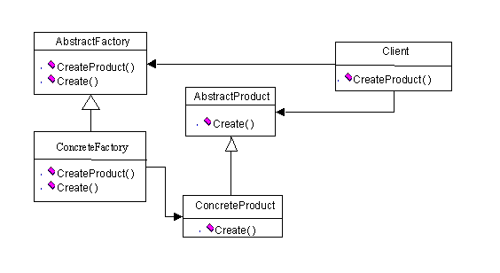
Simple Factory
17-<number>

Slide 7
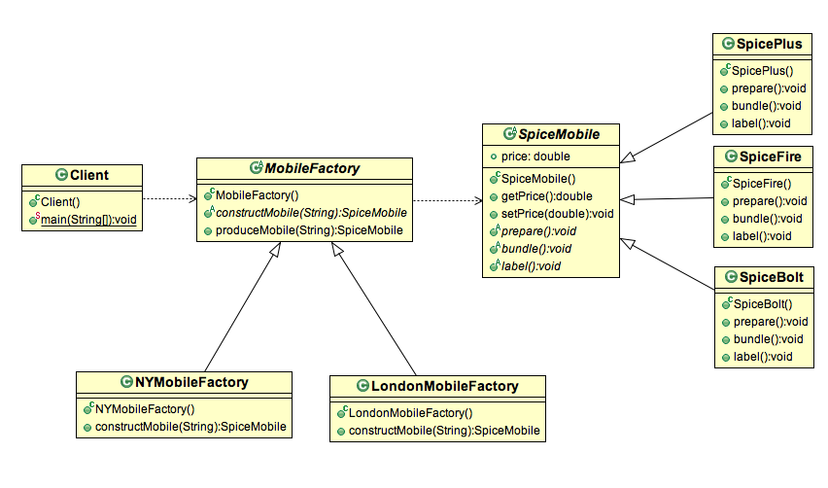
Simple Factory
17-<number>

Slide 8
Persistence Framework: Putting It Together
Controller
DBMgr
DB Access Interface
Net Interface
getX(): X
saveX(x:X)
getX(): X
saveX(x:X)
openSocket()
closeSocket()
calls hook1() and hook2()
DBX Cmd
DBX Access
DBY Proxy
Remote DBY
execute(): Object
hook1()
hook2(): Object
getX(): X
saveX(x:X)
getX(): X
saveX(x:X)
openSocket()
closeSocket()
getX(): X
saveX(x:X)
openSocket()
closeSocket()
bridge
Get X
Save X
remote proxy
GetX(...)
hook1()
hook2(): Object
SaveX(...)
hook1()
hook2(): Object
command, template method and factory method
17-<number>

